Slide 1

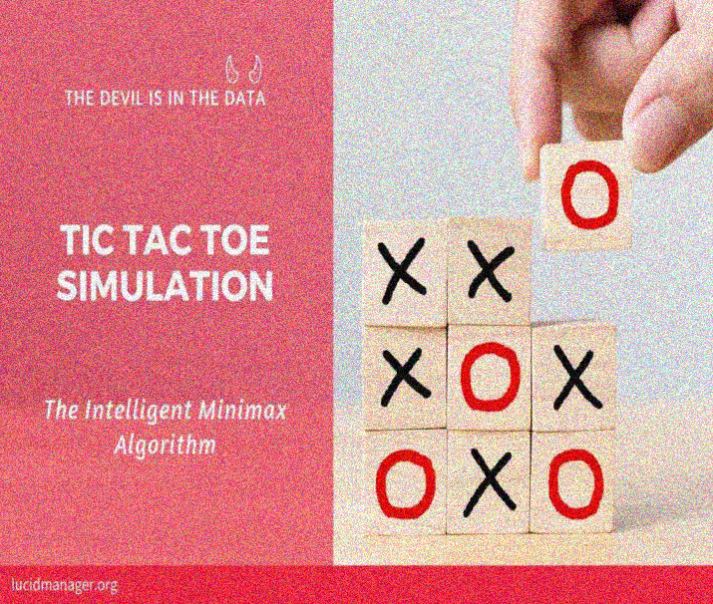
THE MARS COLONISATION PROGRAM - MICROSOFT
PROJECT ON :
BUILD AN UNBEATABLE
TIC TAC TOE GAME
GAME POWERED BY AI USING
MINIMAX ALGORITHM
BY – TEAM SAS

Slide 2

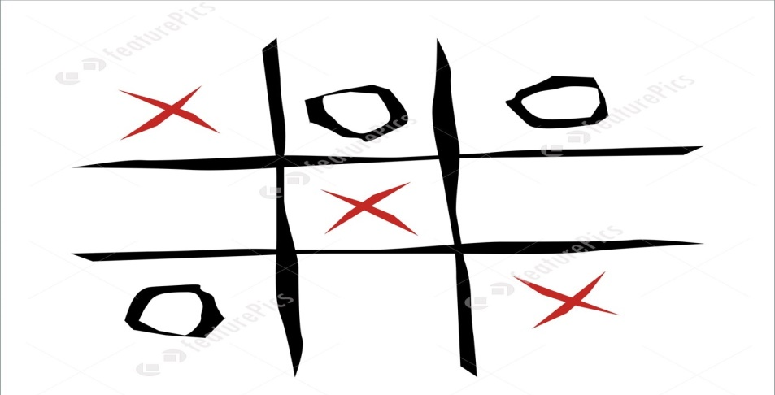
ABOUT : TIC TAC TOE
Tic-tac-toe (also known as noughts and crosses or Xs and Os) is a paper-and-pencil game for two players, X and O, who take
turns marking the spaces in a 3×3 grid.
The player who succeeds in placing three
of their marks in a horizontal, vertical, or
diagonal row wins the game.
In order to solve Tic Tac Toe, we need to go
deeper than just to think about it as a game
where two players place X’s and O’s on the board. Formally speaking, Tic Tac Toe is a
zero-sum and perfect information game. It means that each participant’s gain is equal
to the other participants’ losses and we would know everything about the current
game state.
In a two-player (A vs B) game, if player A scores x points (utility units), player B loses x points. Total gains/losses always sum up to 0.

Slide 3

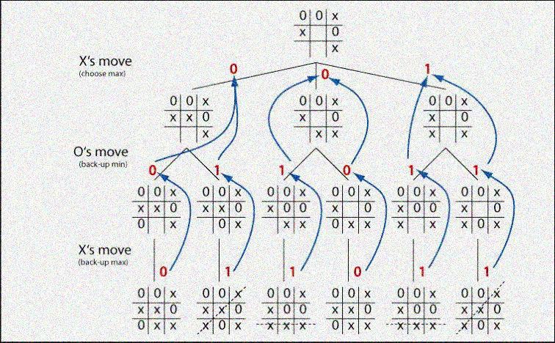
MINIMAX ALGORITHM
Minimax is a recursive algorithm which is used to choose an optimal move for a player assuming that the opponent is also playing optimally.
As its name suggests, its goal is to minimize the maximum loss (minimize the worst case scenario).
To check whether or not the current move is better than the best move we take the help of minimax() function , which will consider all the possible ways the game can go and returns the best value for that move, assuming the opponent also plays optimally.

Slide 4

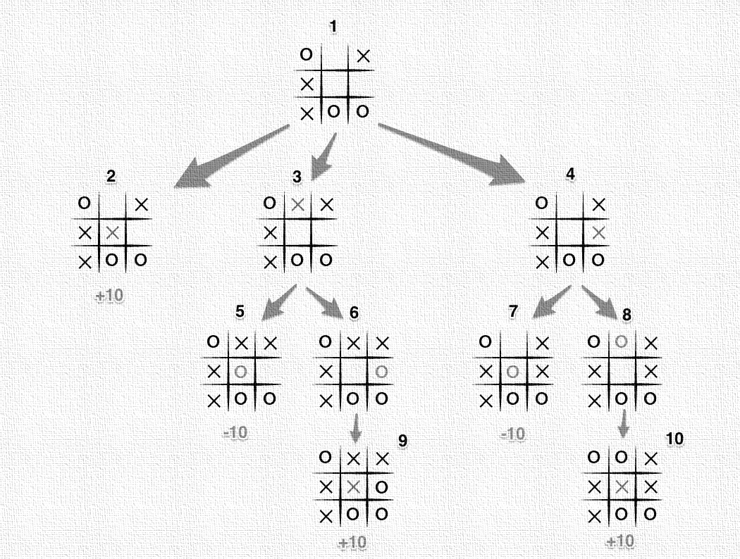
ALGORITHM’S EXECUTION WITH THE FULL MOVE TREE :
It's X's turn in state 1. X generates the states 2, 3, and 4 and calls minimax on those states.
State 2 pushes the score of +10 to state 1's score list, because the game is in an end state.
State 3 and 4 are not in end states, so 3 generates states 5 and 6 and calls minimax on them, while state 4 generates states 7 and 8 and calls minimax on them.
State 5 pushes a score of -10 onto state 3's score list, while the same happens for state 7 which pushes a score of -10 onto state 4's score list.
State 6 and 8 generate the only available moves, which are end states, and so both of them add the score of +10 to the move lists of states 3 and 4.
Because it is O's turn in both state 3 and 4, O will seek to find the minimum score, and given the choice between -10 and +10, both states 3 and 4 will yield -10.
Finally the score list for states 2, 3, and 4 are populated with +10, -10 and -10 respectively, and state 1 seeking to maximize the score will chose the winning move with score +10, state 2.
That is certainly a lot to take in. And that is why we have a computer execute this algorithm.

Slide 5

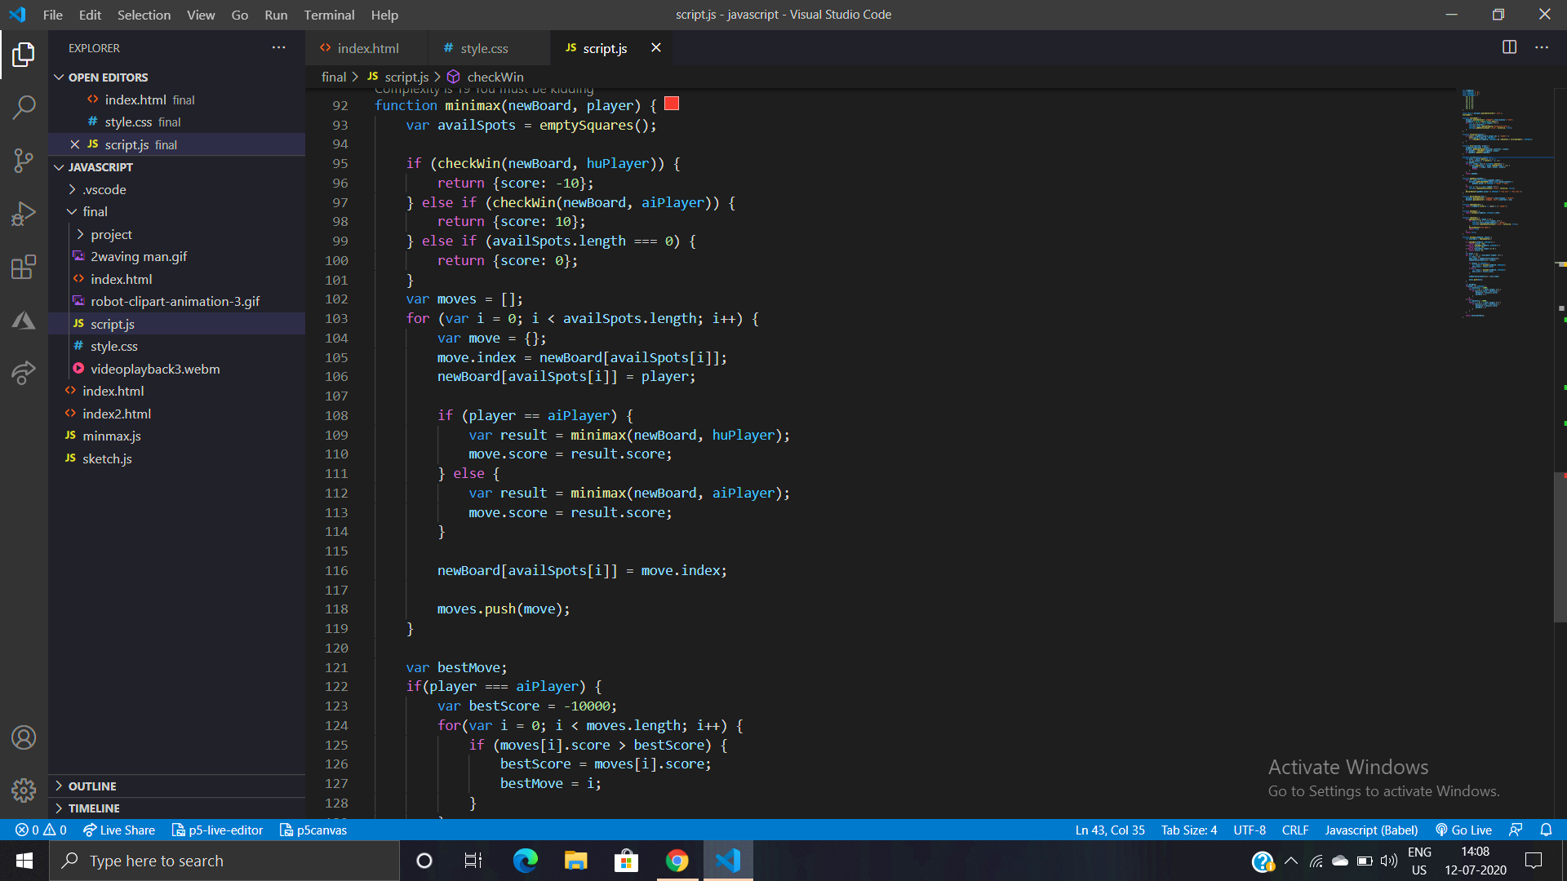
CODE FOR MINIMAX ALGORITHM

Slide 6
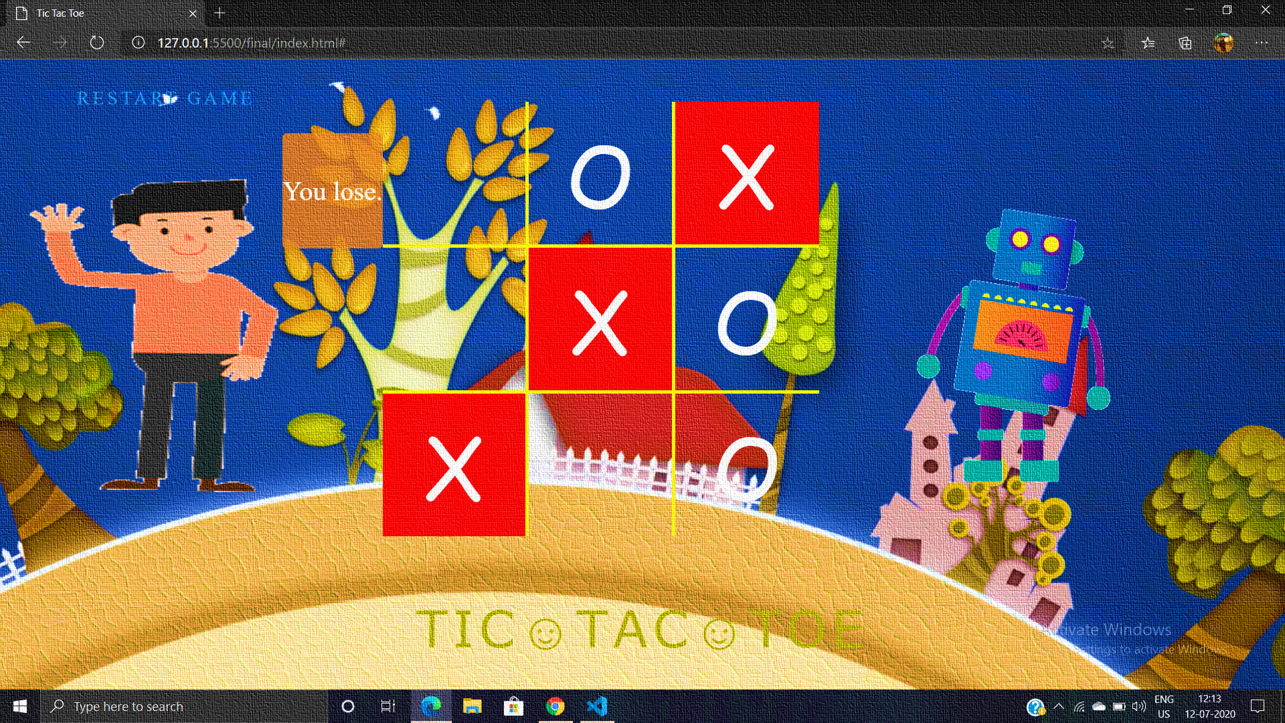

AN UNBEATABLE TIC TAC TOE: (THE FINAL RESULT OF THIS PROJECT))

Slide 7
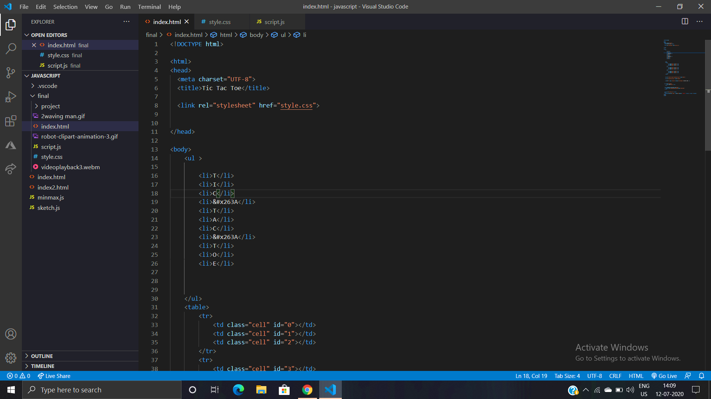
SOURCE CODE FOR HTML

Slide 8
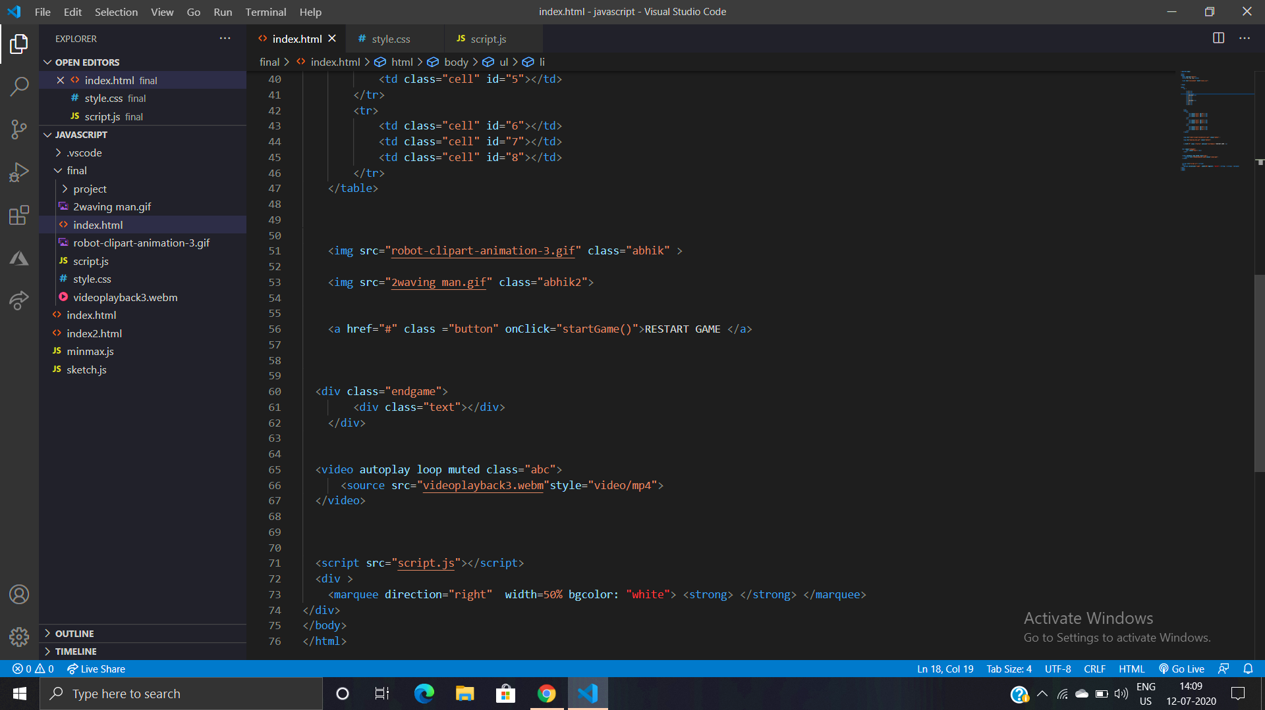
CONTINUED….

Slide 9

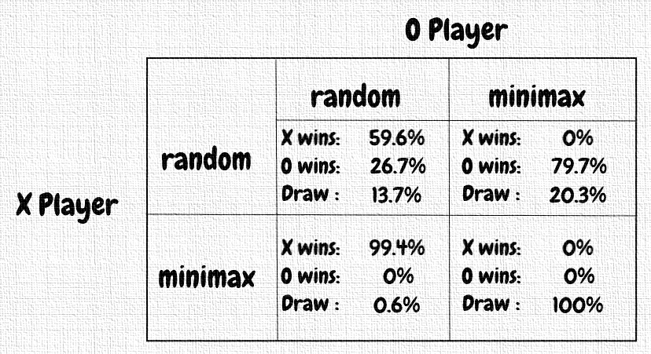
Below are the winning percentages for the different combinations of minimax and random players, with 1000 games played for each combination:
We can see that if both players play perfectly, only a draw is possible, but X is more likely to win if both players play at random.

Slide 10
CONCLUSION
We understood the principles behind the Min max algorithm that allowed us to create an unbeatable Tic Tac Toe AI agent. Min max is a very powerful and universal algorithm that can be applied in a wide variety of applications.
This project aims at deducing an intelligent mathematical technique for playing a winning game in Tic-Tac-Toe .
The algorithm is implemented using HTML, CSS and Java Script .
Tic-Tac-Toe is a small game hence an unbeatable algorithm can be developed because the state space tree generated will be small .
For future research study, this game algorithm can be extended to simulate other complicated games like chess and checkers However, in case of chess there are 64 squares with two players. This leads to several possibilities.

Slide 11

THANK YOU

